Slide 1
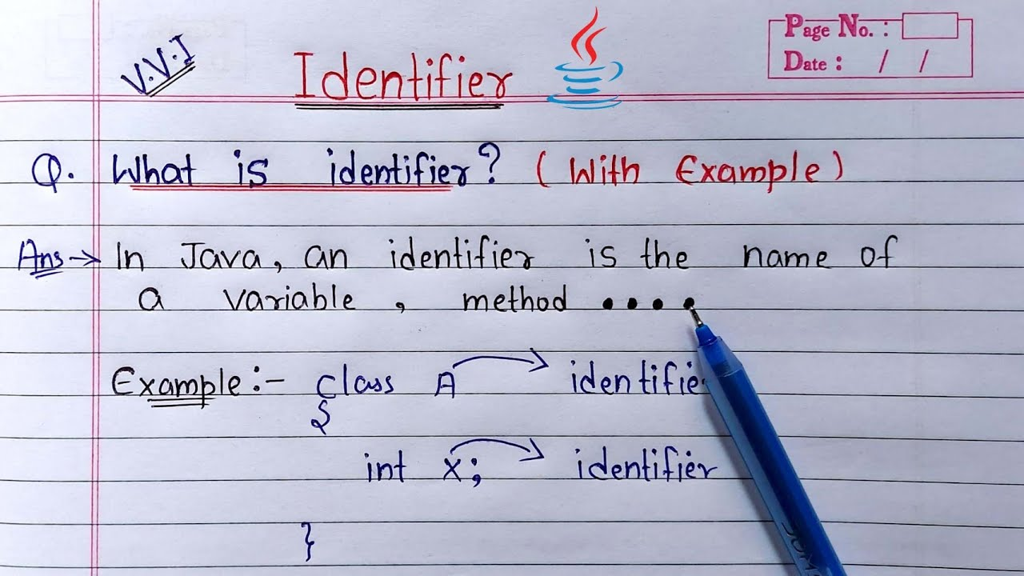
Compiler
First Phase
Lexical (Scanning) Analyzer معجم
Group sequence of characters into lexemes (keywords, identifiers, constants)

Slide 2
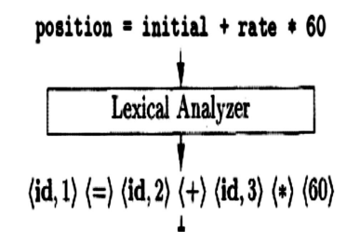
Compiler
First Phase
Lexical (Scanning) Analyzer معجم

Slide 3
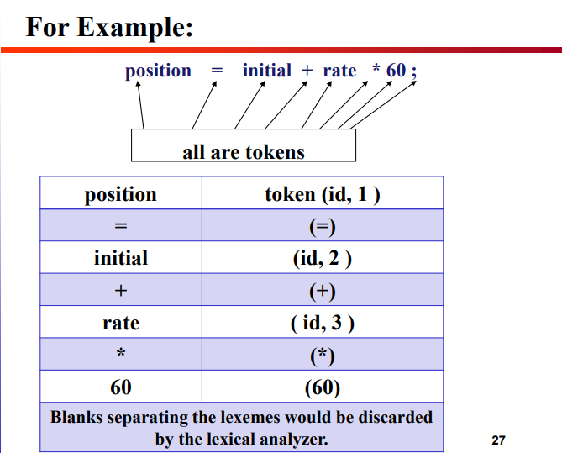
Compiler
First Phase
Lexical (Scanning) Analyzer معجم

